Slide 1

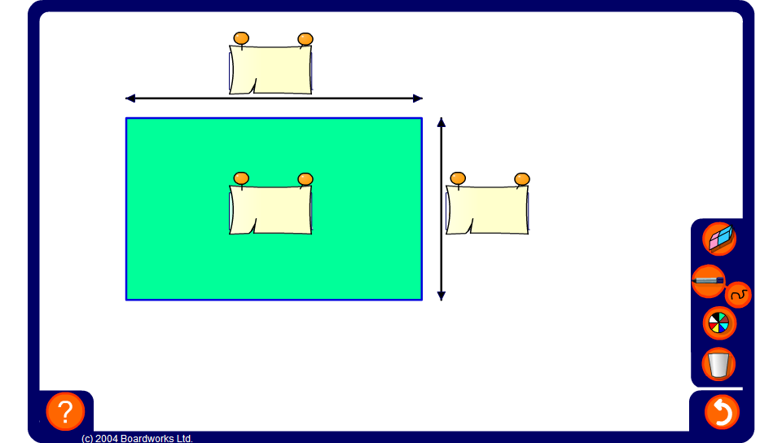


Algebraic areas
Notes:
This exercise may be used as a whole class activity to practice multiplying and dividing terms.
Start by finding areas by multiplying the lengths of the sides.
Remind pupils that the letters stand for numbers, so if a rectangle has sides of length 3a and 6a, for example, one side is twice as long as the other no matter what a is. The corresponding area will be 18a². For example, if a was 2 the sides would be 6 and 12 and the area would be 6 x 12, 72.
It is not necessary to substitute for every example. The aim is to demonstrate the power of algebra to generalize relationships.
Practise dividing terms by finding missing side lengths. Pupils may find this easier to think of if you ask ‘what do I multiply this length by to get this area?’ rather than asking pupils to divide the area by the side length.

